Slide 1
Spatial epidemiology short course Disease cluster analysis
20 November 2023 13:30 – 15:30 The University of Queensland, St. Lucia Campus
Kei Owada
Postdoctoral research fellow
k.owada@uq.edu.au

Slide 2
Schedule
Disease cluster analysis (13:00 – 14:00)
Overview of global and local estimates of spatial and temporal clustering
Point data clustering assessment
Ripley’s K-function, semivariogram
Areal/aggregated data clustering assessment
Moran’s I, Local Indicators of Spatial Association (LISA)
Space-time data clustering assessment
Space-time K-function, SaTScan
Practical session on point data cluster analysis (14:00 – 15:30)
Case study using K-function analysis in R

Slide 3
Disease cluster analysis

Slide 4
Why do we do spatial epidemiological analysis?
Advocacy: delivering information to encourage investment in disease control
Highlighting areas where information is lacking → need more surveillance
Surveillance: investigating how disease distribution changes in space & time, unusual occurrences of disease.
Outbreak investigations; location, source, aetiology of outbreaks
Generating/testing hypotheses about determinants of disease distributions
Relationship between disease and risk factors
Spatial dependence i.e. cause for clustering of a disease
Resource allocation for disease control programmes
Geographic targeting; prioritising treatment/ interventions for populations most at-risk

Slide 5
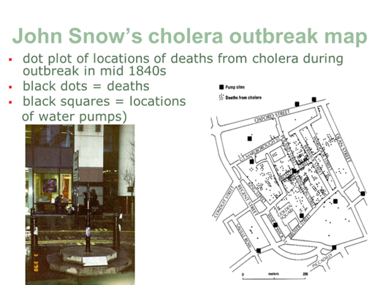
Why do we do spatial epidemiological analysis?
The investigation of possible clustering of a disease is fundamental to spatial epidemiology
Clustering of a disease can occur for a variety of reasons
Infectious spread of disease
Occurrence of disease vectors in specific locations
Clustering of a risk factor e.g. existence of potential health hazards, pollution sources
How do we investigate clustering of a disease?
Source: RSM

Slide 6
Why do we do spatial epidemiological analysis?
We need to determine
whether the clustering is statistically significant and worthy of further investigation;
whether it is likely to be a chance occurrence or if it is a reflection of the distribution of population at risk
Source: RSM

Slide 7
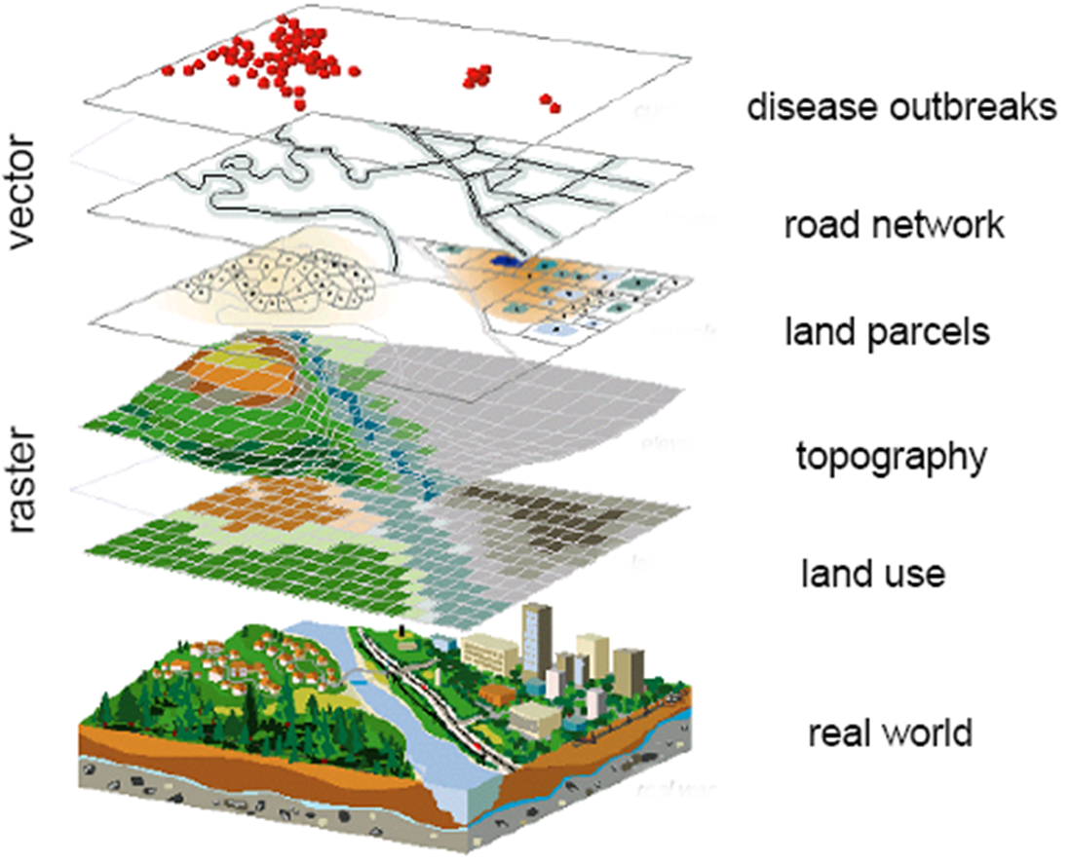
The investigation of possible clustering of disease
We need to know
The location of disease events, e.g.
XY co-ordinates – point source data
Determined using GPS
Reading of map coordinates
Data aggregated by administrative/geographic unit
District, state, province, postcode
Reading of administrative area maps
Source: RSM

Slide 8
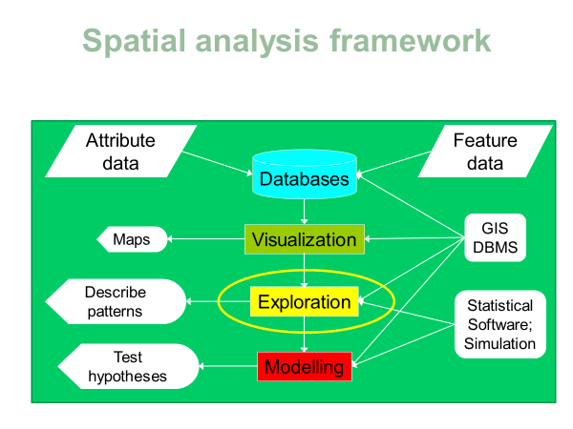
Spatial epidemiological analysis framework

Slide 9
Exploration: spatial dependence
Spatial dependence = spatial (auto)correlation = spatial heterogeneity = clustering
Are disease rates more similar in locations that are closer together in space?
May occur because transmission is facilitated by close proximity
May occur because risk factors are heterogeneous

Slide 10
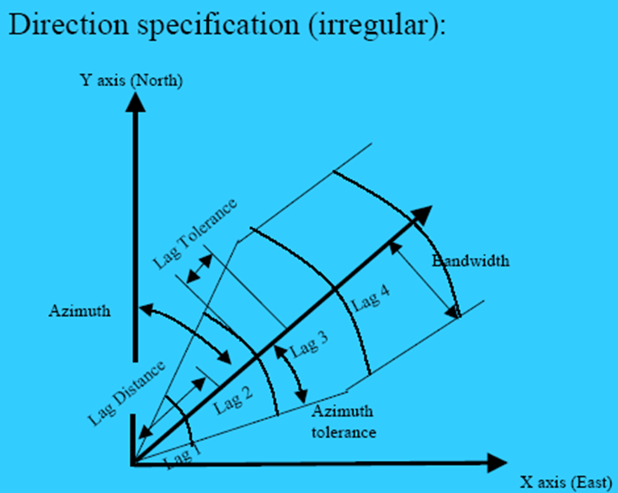
Clustering: spatial dependence
Clustering is a sign of spatial dependence
Basic principle of spatial dependence is that attribute values measured at locations close together are more similar than those from more distant locations.
If dependence structure does not vary, spatial correlation structure is constant across locations = spatial process is termed stationary
If dependence structure varies throughout the area = non-stationary/ heterogeneous
Can spatial dependence be different in different directions?
Source: RSM

Slide 11
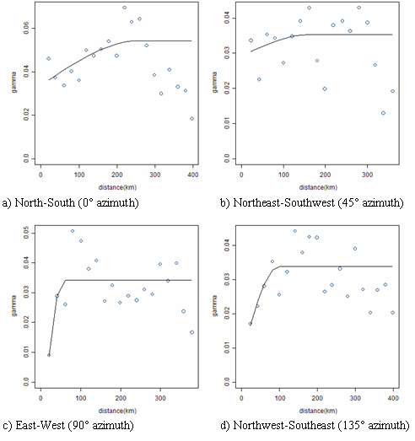
Clustering: spatial dependence
Clustering is a sign of spatial dependence
Spatial dependence can be different in different directions
Isotropic (dependence structure is only affected by distance and not direction)
Anisotropic (dependence is affected by distance and also different in different directions)
If spatial dependence of disease events present in study area, this may be due to heterogeneous risk factors, e.g. spread of infectious disease
Directional semivariograms: Schistosoma haematobium, Northwestern Tanzania
Semivariogram in one direction is different from semivariogram in another direction.
Direction | Range (km) | Sill | Nugget
0˚ | 260.1 | 2E-2 | 3E-2
45˚ | 163.9 | 6E-3 | 3E-2
90˚ | 56.2 | 5E-2 | 0
135˚ | 97.7 | 3E-2 | 7E-3
Source: RSM

Slide 12
Assessment of clustering
Null hypothesis: spatial randomness
Constant relative risk through space (and time)
Alternative hypothesis
Higher than expected rate of disease (around a point or line source)
Types of test statistics/ clustering methods
Global, local
Point, area data
Spatial, spatiotemporal

Slide 13
Clustering methods
Global clustering methods are used to assess whether clustering is apparent throughout the study region but do not identify the location of clusters.
Provide a single statistic that measures the degree of spatial clustering, the statistical significance of which can then be assessed.
The null-hypothesis for global clustering method is ‘no clustering exists’ i.e. random spatial dispersion.
With large raster datasets such as remotely sensed images, global statistics such as Moran’s I run the risk of losing information on spatial autocorrelation since they summarise an enormous number of dissimilar spatial relationships.
Local statistics overcome this problem by scanning the entire dataset, but only measuring dependence in limited portions of the study area.

Slide 14
Clustering methods
Local method of cluster detection defines the locations and extent of clusters
Can be further divided into focused and non-focused tests.
Non-focused tests identify the location of all likely clusters in the study region;
Focused tests investigate whether there is an increased risk of disease around a pre-determined point, such as a coal power plant or chemical factory.
Used to define the characteristics of clusters such as their location, size and intensity.

Slide 15
Cluster analysis
Point data clustering assessment

Slide 16
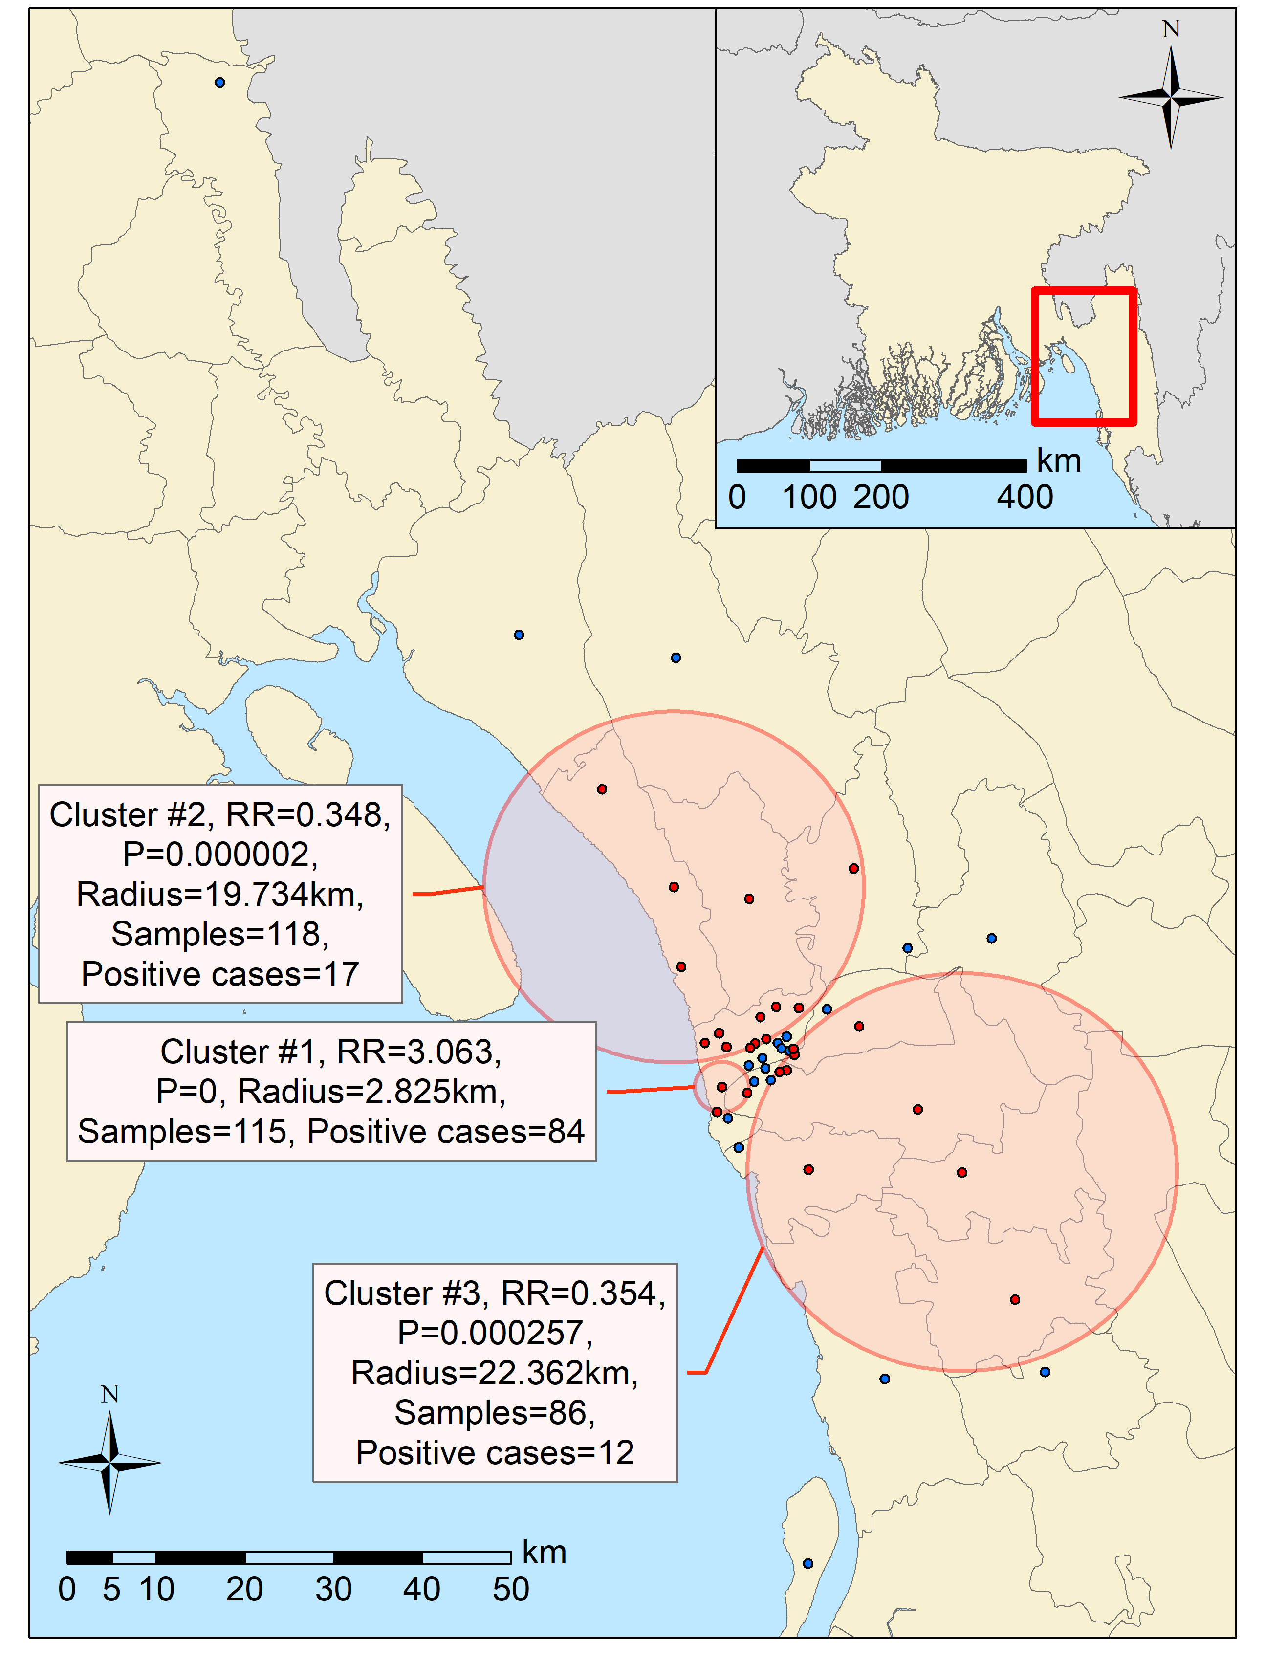
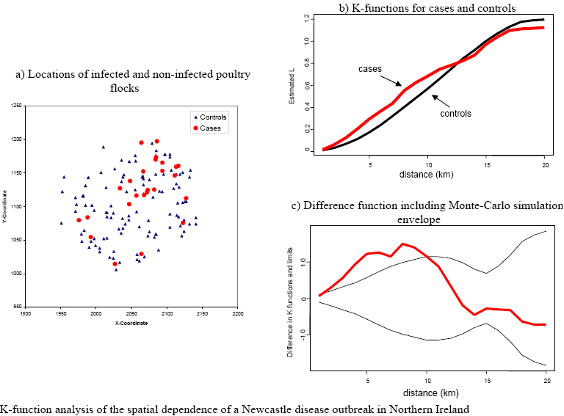
Point data clustering assessment approaches
Cluster analysis can form hypotheses based on presence of clustering
Different approaches can be used to identify clustering of point data
Semivariograms (top-left)
Determine clustering size of all data points
SaTScan (right)
Determine locations of clusters and sizes
Ripley’s K-function (bottom-left)
Estimate the presence and size of spatial clustering of cases compared to controls
Source: KO
Source: KO
Source: RSM

Slide 17
Methods for point data
Other example of approaches that explore disease point data for evidence of clustering.
Openshaw’s Geographical Analysis Machine (GAM)
Involves applying a fine grid across a study area and generating a series of circles of varying radii with their centres based at each intersection of the grid. The observed number of cases of disease within each circle is then compared with the expected number of cases.
Turnbull et al. (1990) applied the GAM to investigate clustering of leukaemia incidence in northern New York.
Kulldorff’s SaTScan
Kulldorff implemented SaTScan (spatial and temporal scanning of clusters).
Uses cluster detection method based on scan circles.
It searches for clusters in datasets using 2 different probabilistic models (Bernoulli – case v control; Poisson – case v population data). More example Kulldorff and Nagarwalla (1995).

Slide 18
Methods for point data
Cuzick & Edward’s k-nearest neighbour test
A test for spatial clustering that takes into account the potentially heterogeneous distribution of the population at risk. It is based on the locations of cases and randomly selected controls from a specified region and includes a spatial scale parameter k (the number of nearest neighbours). For each case, the test counts how many of the k-nearest neighbours are also cases.
Example studies: Carpenter et al (2006) study on clustering of abortions among Danish dairy herds; Perez et al (2002) on clustering of bovine TB in Argentina.
Ripley’s k-function
Estimate the presence and size of spatial clustering of cases compared to controls
Identifies the distance at which clustering occurs.
Number of pairs of points separated by given distance
Example study: Abernethy et al (2000) on clustering of poultry flocks affected with Newcastle disease in Northern Ireland.

Slide 19
Cluster analysis
Analysis method example 1:
Semivariograms

Slide 20
Cluster assessment using Semivariograms
What is a semivariogram?
Semivariogram depicts the spatial autocorrelation of the measured sample points. Once each pair of locations is plotted, a model is fit through them.
Spatial autocorrelation is the degree to which observations at spatial locations are similar to each other; it is a measure of correlation between nearby observations

Slide 21
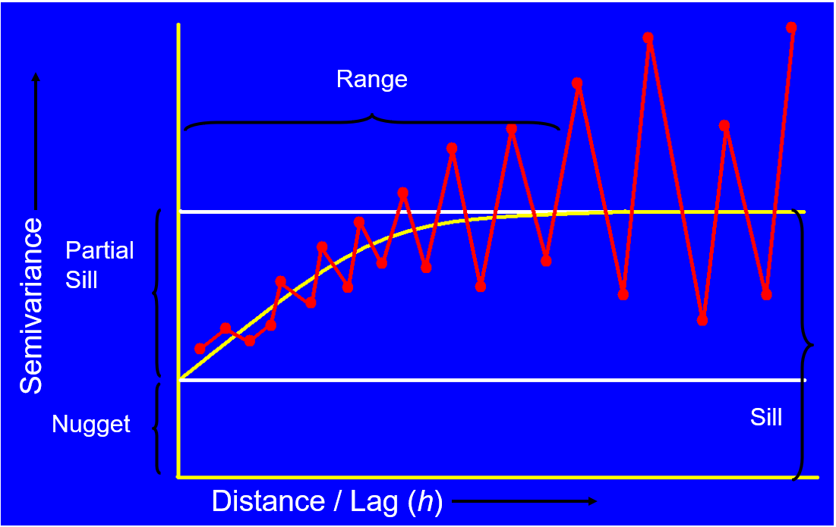
Interpreting a semivariogram
Semivariograms are defined by three parameters:
Nugget (y value at x=0), random variation at a scale smaller than the smallest bin
Sill (maximum semivariance value)
Range (the lag distance where the sill is reached).
The difference in semivariance between the sill and the nugget is called the partial sill.
Semivariance
Semivariance is the sum of squared differences between pairs of values at distance h, divided by twice the number of such pairs
Source: RSM

Slide 22
Interpreting a semivariogram
Exponential shape with values increasing with distance indicates the existence of a spatial autocorrelation.
Sample locations separated by distances closer than the range are spatially autocorrelated, whereas locations further apart than the range are not.
If no spatial autocorrelation then the semivariogram will be flat.
Semivariance
Semivariance is the sum of squared differences between pairs of values at distance h, divided by twice the number of such pairs
Source: RSM

Slide 23
Examples of semivariograms
Spatial autocorrelation found No spatial autocorrelation Weak spatial autocorrelation
Semivariograms for STH prevalence data with maximum distance of 2.5 degrees (Source: ACAC and RSM)

Slide 24
How to create semivariogram in R
Example of creating a semivariogram will be shown using R
R is a free statistical data analysis tool
Available from: https://www.r-project.org/
Various functionality can be added to R through downloadable packages
To create a semivariogram, you need to install the package: geoR
Can also use RStudio
A tool that provides a more interactive interface for R

Slide 25
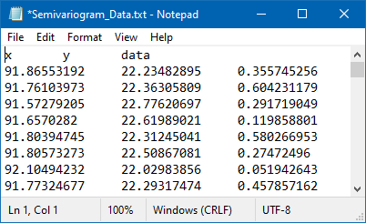
Preparing data for use in R
Store data in a tab-spaced text file with three columns: x-coordinate (x), y-coordinate (y), data value (data)
Data value column can be your observed data or residual data from a model
Data file can be loaded with the command:
myGeoData <-read.geodata("Semivariogram_Data.txt", head=T, coords.col=1:2,data.col=3)

Slide 26
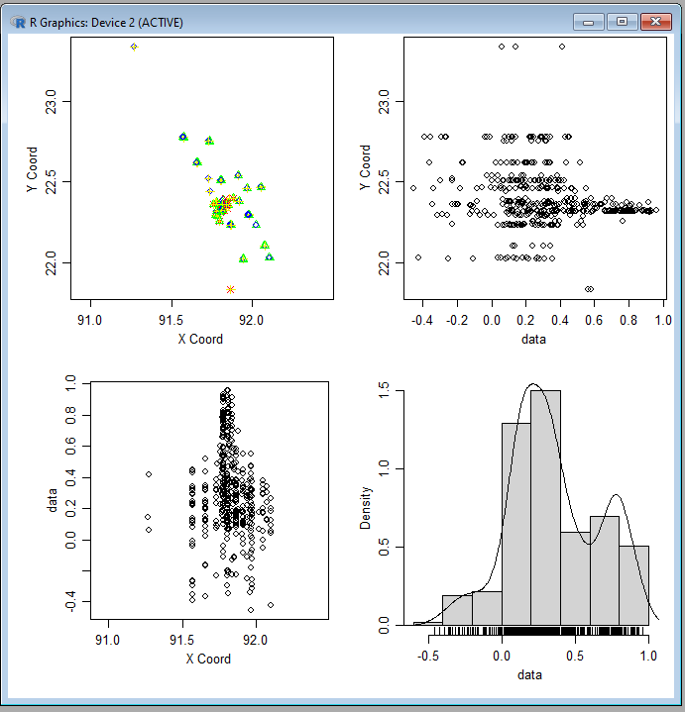
Plotting source data
You can create a series of plots visualising your data points using the command:
plot.geodata(myGeoData)
This will create four plots in one figure. Clockwise from top left:
Study area xy coordinate plot
Y coordinate distribution
Data point density
X coordinate distribution

Slide 27
Choosing parameters to plot your data
Two parameters: number of bins and distance
How many bins?
Depends on density of data points
Usually 10 to 20 bins
Use more bins when range is larger
We will use 10 bins in this example
What distance to use?
Should be estimated up to half the length of the shortest axis of study area
Can be calculated by taking maximum and minimum values of X and Y from data set
For data in this example,
X coordinate range is shorter than Y (0.835 vs 1.499 degrees)
Half distance of x axis is therefore 0.417 degrees
X range
Half X range
Y range

Slide 28
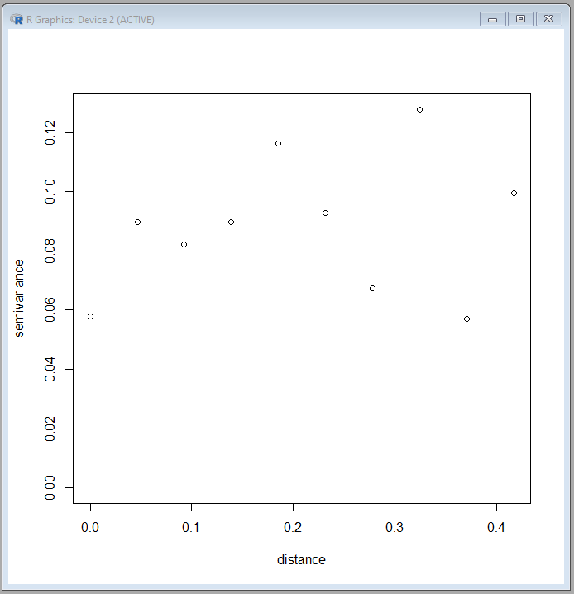
Plotting data
Using the parameters of 10 bins and 0.417 distance, we can plot the data using the following commands:
binNum=10
halfDist=0.417
binl<-variog(myGeoData,uvec=seq(0,halfDist,l=binNum))
plot(binl)

Slide 29
Estimating semivariogram parameters
From the data plot, we visually identify the estimated semivariogram parameters
Use a rough curve through the bin points starting at first point and levelling out at best fitting semivariance value.
Nugget = 0.058
Sill = 0.104
Range = 0.245
Range
Nugget
Sill

Slide 30
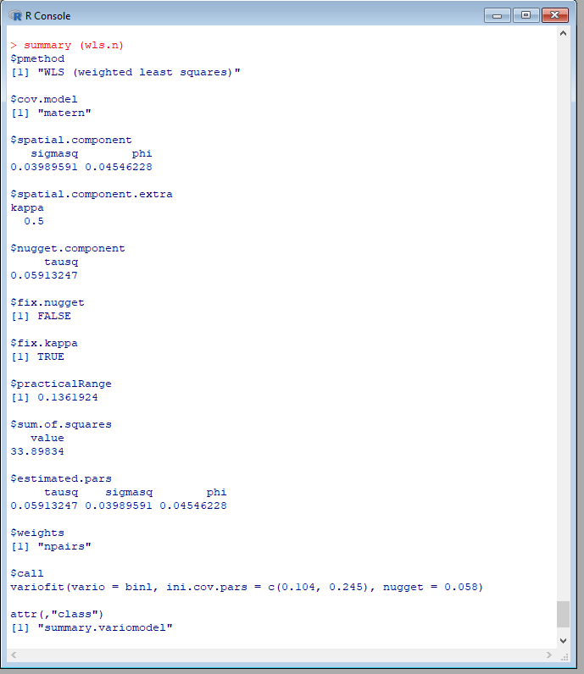
Testing fit of semivariogram parameters
Evaluate the fit of your chosen parameters with the command:
wls.n<-variofit(binl,ini=c(0.104,0.245), nug=0.058)
summary(wls.n)
Note order of parameters (sill, range, nugget)
From the output of these commands
practicalRange should be less than your distance (0.417)
tausq = Revised value for third parameter for variofit
sigmasq = Revised value for first parameter for variofit
phi = Revised value for second parameter for variofit
Rerun above variofit command with new values

Slide 31
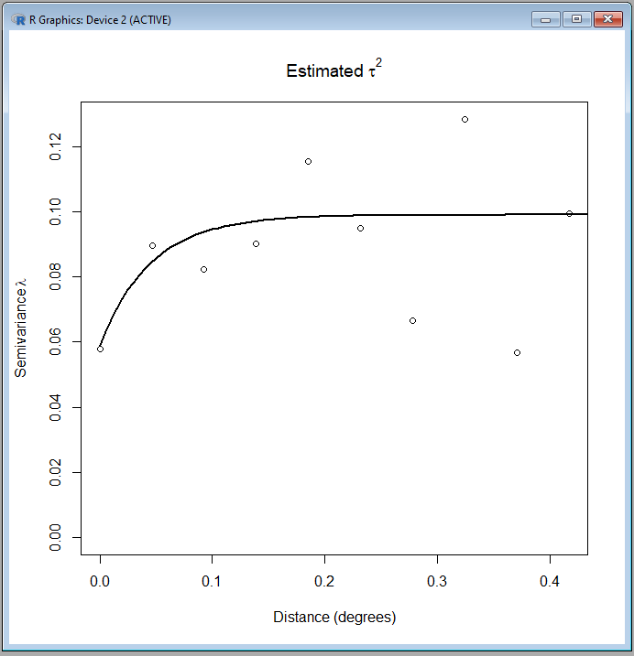
Fitting and plotting semivariogram parameters
Rerun variofit command with values from previous execution of the command
Repeat this until the values for tausq, sigmasq, and phi stabilise.
Once values have stabilised, plot the fitted curve on the semivariogram with the following commands:
plot(binl,main=expression(paste("Estimated ", tau^2)), xlab="Distance (degrees)", ylab=expression(paste("Semivariance", lambda)))
lines(wls.n,lty=1,lwd=2,max.dist=0.5)
legend(4,300,legend=c("WLS",lty=c(1),lwd=(1),cex=0.7))
From this shape semivariogram, we can determine spatial autocorrelation is present at the value for practicalRange
1 degree is approx. 111km therefore 0.136 × 111 = 15.1km

Slide 32
Cluster analysis
Analysis method example 2:
K-function analysis

Slide 33
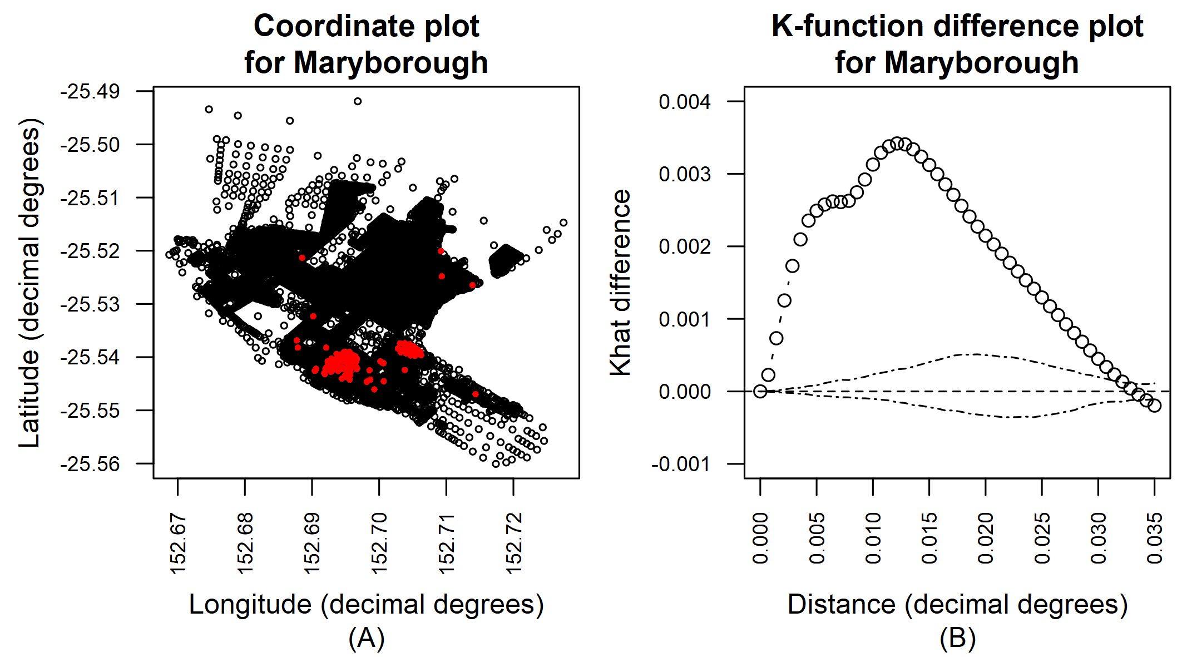
K-function analysis
K-function analysis is a method of estimating the presence and size of clustering of spatial data
K-function provides details of
Average cluster size
Signs of spatial clustering
Spatial trends
K-function uses case and population point data, e.g. infected individuals and uninfected individuals
Can be perform using R

Slide 34
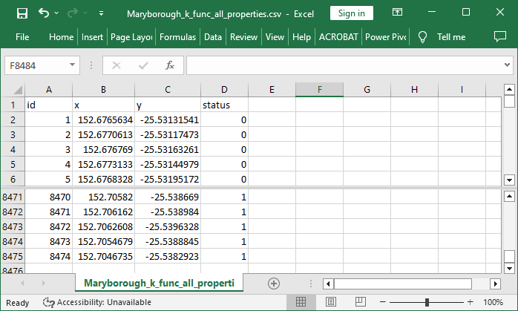
Data required for K-function analysis
Data consists of four fields
id: Unique identifier for each data point
x: longitude
y: latitude
status: case = 1 or control = 0
For this example, we are using fictional data in the Queensland suburb of Maryborough with:
Case = properties where resident has been infected with fictional Disease X
Control = properties where resident has no history of being infected with fictional Disease X

Slide 35
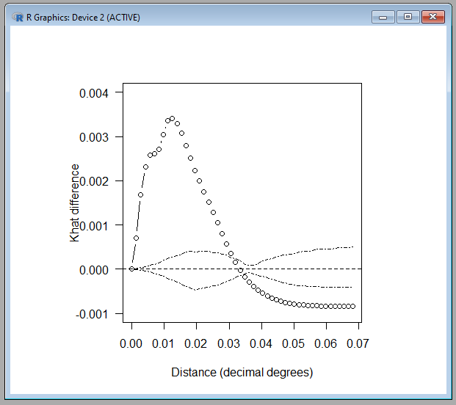
Running K-function analysis in R
The output of K-function analysis is a plot of the k̂ (khat) difference function, which is the result of spatial autocorrelation simulation, for both properties with residents with and without a history of being infected with fictional Disease X
Plot of the results shows Khat difference (Case Khat – Control Khat) (bubble line) against the case-control simulation envelope (dotted lines)
To better understand the results, we want to focus on the area to the left of where the bubble line crosses the envelope (red circle in figure)
Lines cross at slightly greater than 0.03 decimal degrees (red line in figure)
We will rerun and limit distance to 0.035 so the line intersection point is slightly offset from the right edge of the plot

Slide 36
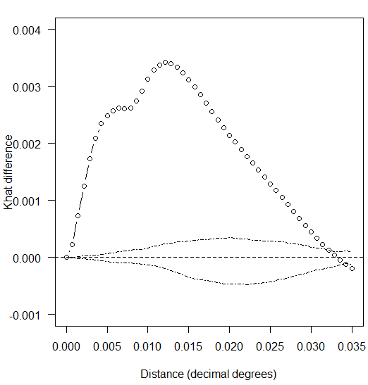
Running K-function analysis in R
Limiting distance to 0.035 produces an easier to interpret K-function plot
We can see the two lines cross at 0.032 degrees (approximately 3.5 km)
For closer analysis, we will print a combined figure of K-function plot and coordinates of cases and controls

Slide 37

Interpretation of K-function analysis
Connections can be drawn between coordinate plot and K-function difference plot
When bubble line (k-function) is above dotted line (simulation envelope plot), the distribution is more clustered than a random distribution at that distance
Crossover point marks when correlation stops
Cluster strength indicated by distance between bubble line and dotted line
The first peak (blue) indicates average clustering of fictional Disease X within 0.006 degrees (approx. 666 m) distance compared to properties with no history of Disease X
Second peak (pink) indicates circumscribed clustering at 0.0119 degrees (approx. 1.32 km)
Gradually decreasing cluster strength (orange) for fictional Disease X up to 0.032 degrees (approx. 3.5 km) apart
Note: 1 decimal degree = Approx. 111 km

Slide 38
Cluster analysis
Areal/aggregated data clustering assessment

Slide 39
Working with areal/aggregated data
Point data can easily be aggregated and area data can be represented as points e.g. by using the centroids of the areas.
Point data can be aggregated to total/average of an administrative unit
How does level of aggregation impact analysis?
High level aggregation; less detailed estimates. Assumed homogeneity
Low level aggregation; few cases in area so estimates prone to random variation

Slide 40
Clustering methods for aggregated data
The local Moran test (Anselin 1995)
Moran’s I test detects local spatial autocorrelation in aggregated data by decomposing Moran’s I statistics into contributions for each area within a study region.
Correlation coefficient for values in neighbouring units
Weighted to account for geographical proximity
Example study: Greiling (2003) used the local Moran statistics to analyse spatial clustering in diagnoses of breast and lung cancers on Long Island identifying significant spatial clustering for these diseases.

Slide 41
Methods for areal data
Other indicators of local clustering that measures the concentration of a spatially distributed attribute variable.
E.g. Getis and Ord (1992) use the Gi(d) statistic to explore the spatial pattern of sudden infant death syndrome by country in North Carolina.
Local Indicators of Spatial Association (LISA) detect clusters of either similar or dissimilar disease frequency values around a given aggregated area.
The extent of the ‘mix’ of pairs among the 4 types of association in the quadrants of the plot defined by the axes (low-high, high-high, high-low and low-low) provides and indication of the suitability of the spatial association throughout the data
Software for implementing a local Moran test includes the spdep package in R.

Slide 42
Cluster analysis
Space-time data clustering assessment

Slide 43
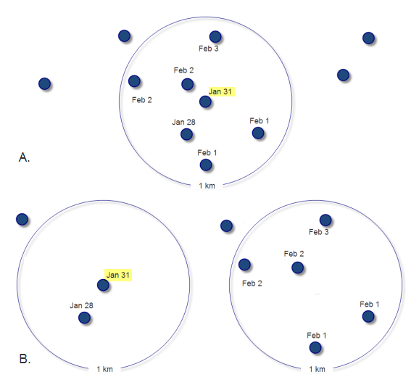
Clustering of space-time data
While spatial patterns of disease are of great interest, space-time interactions are also important.
We need to evaluate whether cases that are close in space are also close in time.
Quantify the pattern and intensity of spread of a disease at various distances from any given location and the time dimension can then be used to estimate the rate of spread.
Space-time analysis looks at the magnitude and characteristics of the space–time interaction and can be used as an indicator of local spread of disease during an outbreak (Picado et al, 2007)
Source: ESRI

Slide 44
Methods for space-time cluster detection
Knox’s method
This method quantifies space-time interaction for point data, through counting pairs of cases that are separated by less than critical space and time distances.
It assumes that any change in the population at risk occurs evenly across the distribution under study. This assumption would have serious analytical implications where interventions such as vaccination may cause inhomogeneous changes in the population at risk.
E.g. Norström et al (2000) investigated outbreaks of acute respiratory disease in Norwegian cattle herds.
Jacquez’s k nearest neighbour test
Test for space-time interaction for point data that counts the number of case pairs that are nearest neighbours in both space and time
E.g. Ward and Carpenter (2000) evaluated space-time cluster tests to investigate clustering of blowfly catches on a commercial sheep property in Australia between 1997 and 1998.

Slide 45
Methods for space-time cluster detection
The space-time K-function
Space-time cluster detection can be done using splancs package in R
E.g. Picado et al (2007) used the space-time K-function to investigate different aspects of the 2001 UK FMD epidemic.
Kulldorff’s spatial scan statistic/ space-time cluster detection (SaTScan)
Software designed to look for clusters in space and time
Use of the space-time scan statistics with repeated time periodic analysis can be used as part of a surveillance system to track active clusters of disease and for detecting the geographic location of emerging clusters.

Slide 46
What is SaTScan?
SaTScan is a free statistics software that analyses spatial, temporal and space-time data
Accepts both point and area data
Detects location of spatial clusters or location and time of space-time clusters
For spatial clusters, uses a moving circular window
Performs likelihood ratio test to determine if rate inside is higher/lower than rate outside the circle (e.g. prevalence of infection)
For space-time cluster, uses a cylinder
Selects most likely cluster with relative risk (RR) and P value based on Monte Carlo simulation test for significance
Disadvantages:
Currently only detects circular clusters
Subjective definition of maximum cluster size (User needs to specify maximum percent of population at risk)
Source: KO

Slide 47
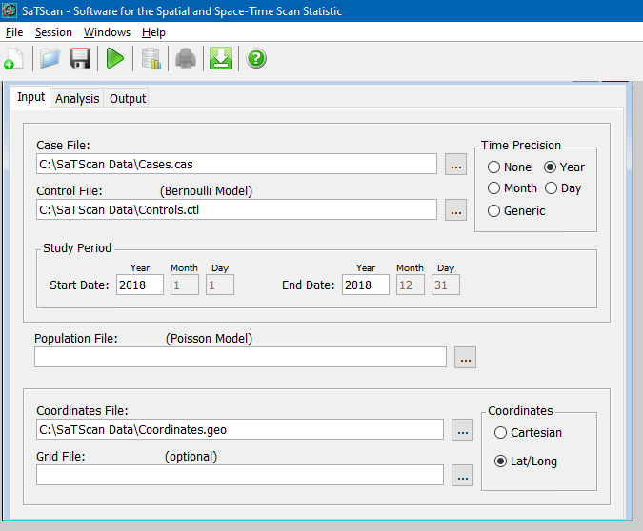
How to use SaTScan
Download from https://www.satscan.org/
Example for a Bernoulli spatial model:
Prepare dataset in three files:
Case file:
<Location ID> <Number of Cases> <Date/Time>
Control file:
<Location ID> <Number of Controls> <Date/Time>
Coordinates file:
<Location ID> <Latitude> <Longitude>
For spatial-only analysis, use same date for all data
If using Poisson model, you will need to add population file as well.

Slide 48
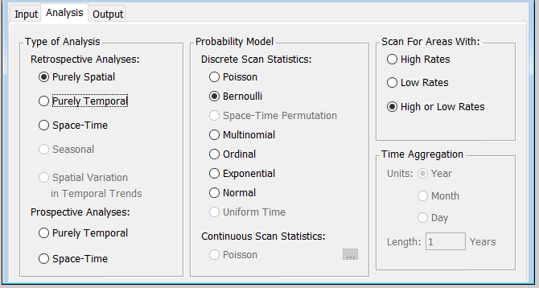
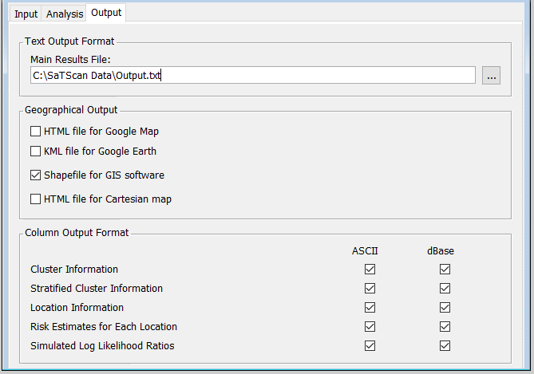
How to use SaTScan
For this example, we have set the analysis parameters to perform a Purely Spatial analysis with a Bernoulli model (probability of infection)
Scanning for areas with High or Low Rates will look for both clusters of cases and clusters of controls
Output summary provided in text file
Describes each detected cluster in terms of location, size, relative risk, number of cases and controls, etc
Option to create shapefile for plotting in map

Slide 49
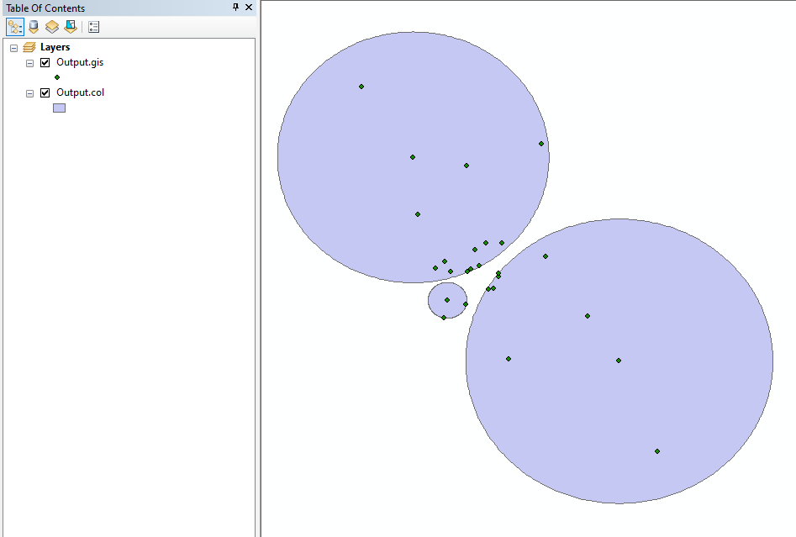
Mapping clusters from SaTSCan in ArcMap
SaTScan generates two shape files
Coordinates contained in clusters
Cluster circles
Clusters can be combined with other map data such as administrative units of your study area in ArcMap
SaTScan shape files contain details of clusters, which can be used for creating labels on the map in ArcMap
Source: KO

Slide 50
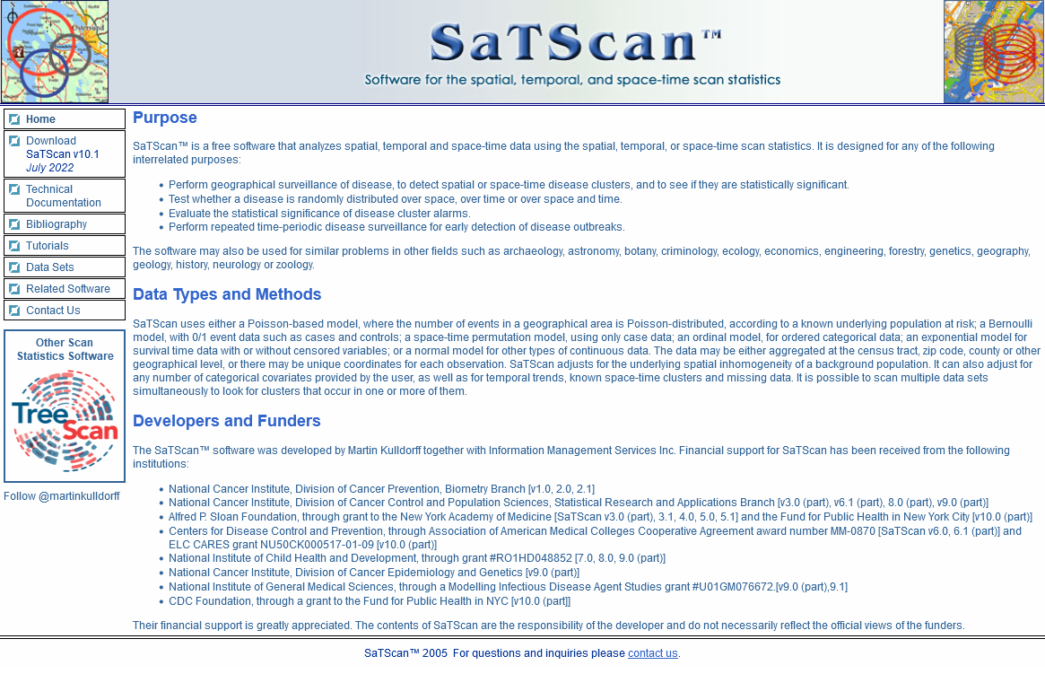
SaTScan resources
SaTScan available from: https://www.satscan.org/
Several tutorials available on using the software
Useful for learning all of the features of the software

Slide 51
Summary of content covered
Clustering of a disease can occur for a variety of reasons
The investigation of clustering is fundamental to spatial epidemiology
Cluster analysis is the second stage of spatial analysis
Data exploration after visualisation of spatial patterns
Different cluster analysis approaches exist to cater for different data types
Selecting appropriate cluster analysis methods requires understanding of these different approaches and data requirements (points, areal)

Slide 52
Practical session:
Case study using K-function analysis in R

Slide 53
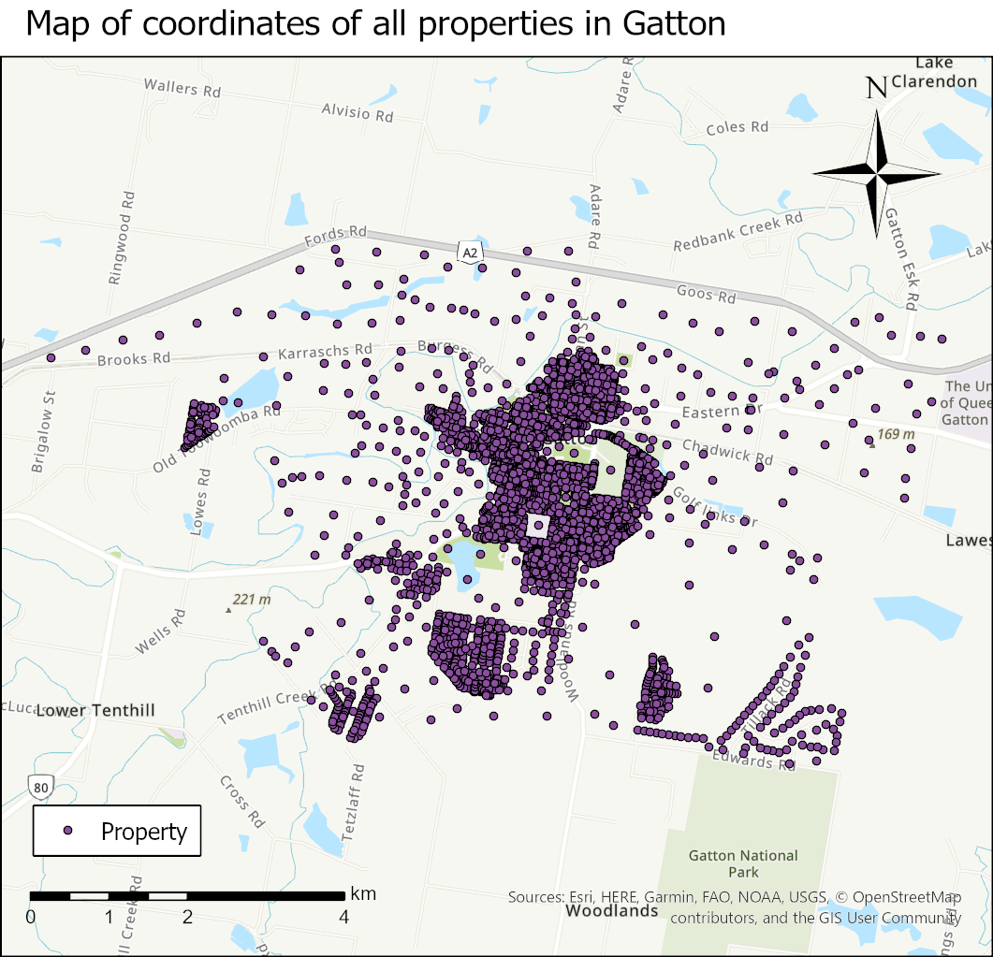
Case study: Fictional Disease X in Gatton
Fictional scenario based on point data from single time reference.
You have been asked to investigate the situation of a new disease that has been reported at a number of properties in Gatton called “Disease X”.
You need to investigate if there is any spatial clustering in the reports of Disease X. To do this, you will need case and population data.

Slide 54
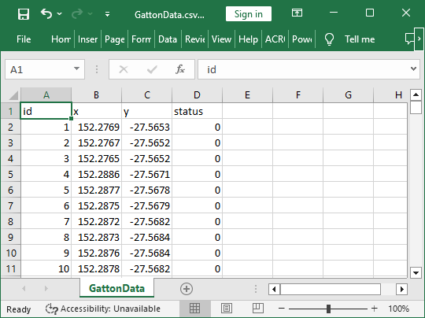
Dataset for case study
In this exercise, we will define a case as a property where Disease X has been reported at least once and population as all properties where Disease X has not been reported.
You will be using a dataset containing the coordinates (latitude and longitude) of all properties in Gatton, with case properties assigned a value of 1 and population properties assigned a value of 0.
We will perform spatial K-function analysis on this dataset to identify clustering in Gatton

Slide 55
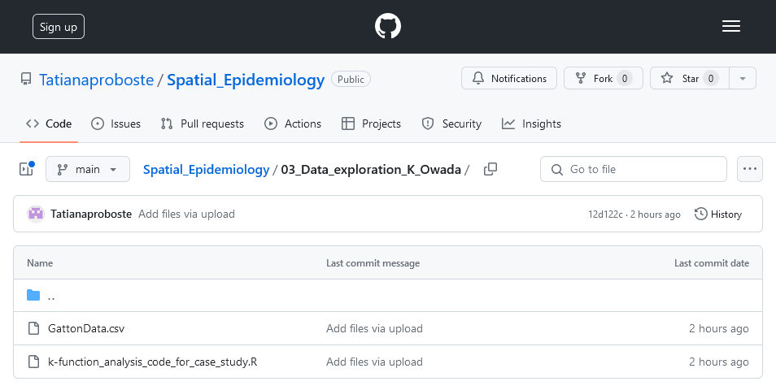
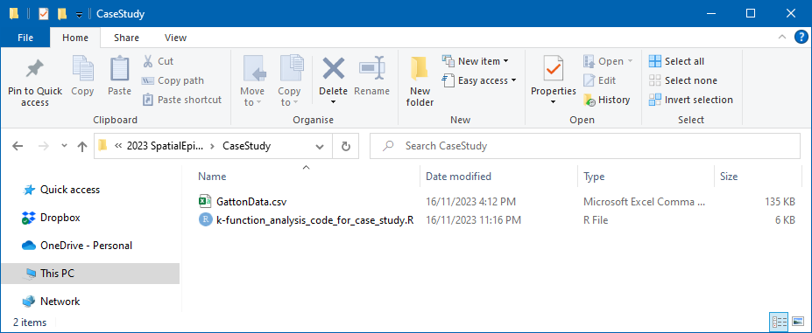
Files required for K-function analysis
Files available from:
https://github.com/Tatianaproboste/Spatial_Epidemiology/tree/main/03_Data_exploration_K_Owada
Files to download
k-function_analysis_code_for_case_study.R (Code for K-function analysis)
GattonData.csv (Dataset for fictional Disease X in Gatton)

Slide 56
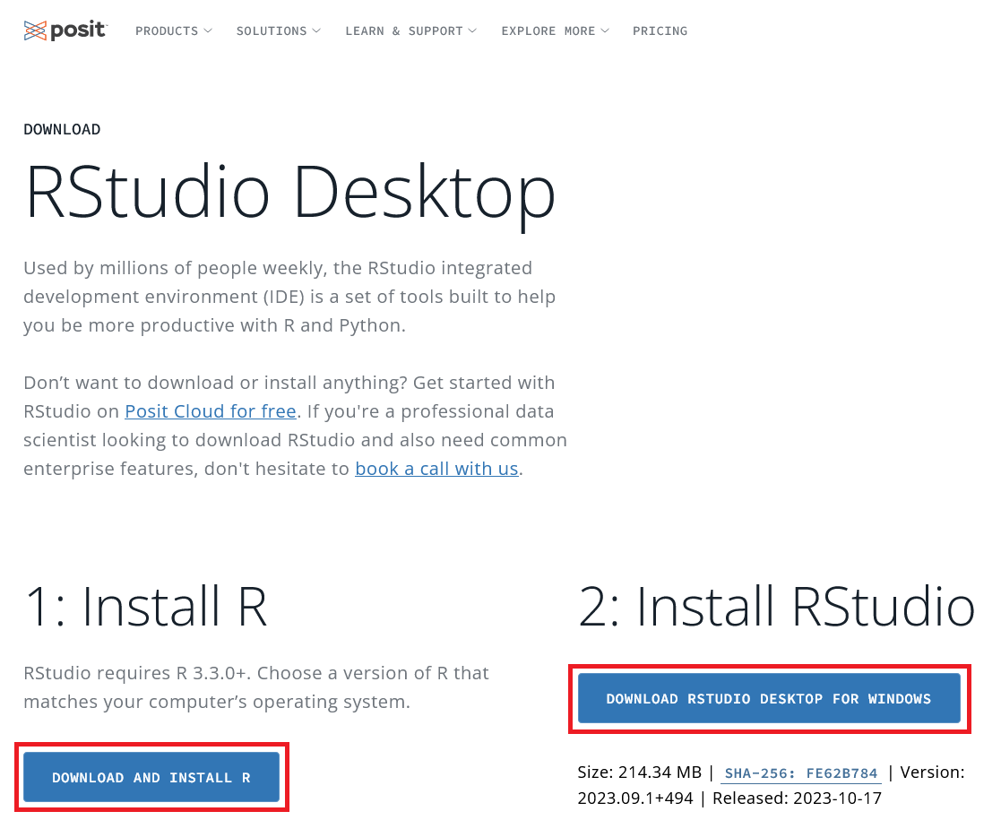
Installing R and RStudio
K-function analysis will be performed using code written in the R software environment. This will require two free-to-use programs to be installed:
R
RStudio
Use the following website to access download links for both of these programs:
https://posit.co/download/rstudio-desktop/
From this page, there are two links for downloading R and RStudio.

Slide 57
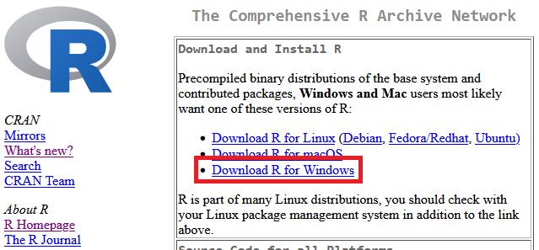
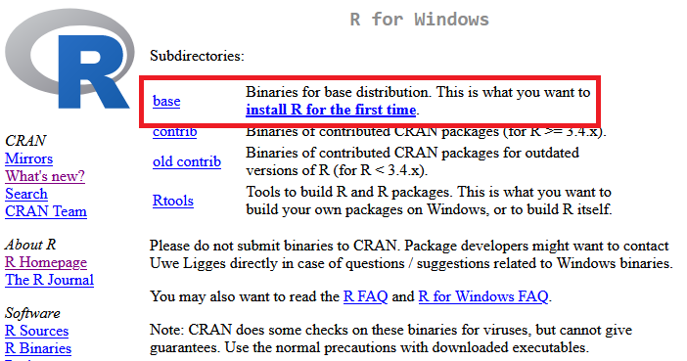

Installing R and RStudio
Click on the blue button labelled “DOWNLOAD AND INSTALL R”.
This will take you to the R download page. From this page, click on the link for “Download R for Windows”.
On the following page, click the link to “install R for the first time”. This will then take you to a page with a link to the current version of R. Click on the download link at the top of the page and R will begin downloading.
After R has downloaded, return to the RStudio download page and click on the blue button labelled “DOWNLAD RSTUDIO DESKTOP FOR WINDOWS”. This will initiate the download for RStudio

Slide 58
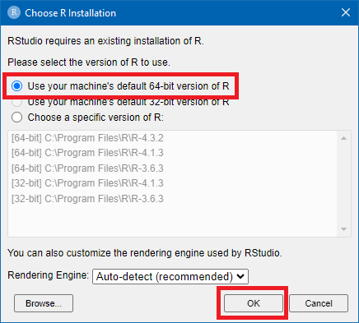
Installing R and RStudio
Install R and then RStudio, in that order
Use default options in both installers
Upon first opening RStudio, you may be asked which installation of R to use with RStudio, especially if you have older versions of R already installed on your computer.
Choose the option to “Use your machine’s default 64-bit version of R” to automatically select the version of R just installed.

Slide 59
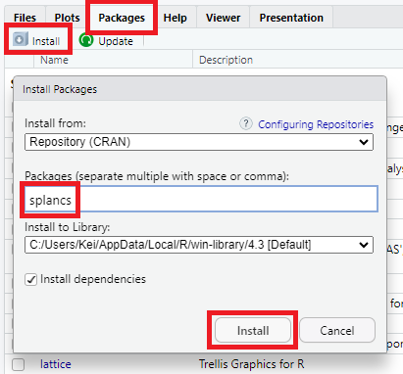
Installing splancs package in RStudio
In the bottom right panel of the RStudio interface, open the “Packages” tab and click on the “Install” below it.
This will bring up an “Install Packages” window.
Enter “splancs” into the “Packages” textbox and click “Install”.
A number of messages will appear in the console window following the installation of the “splancs” package.
It is safe to ignore any warnings related to “Rtools”, so long as the console states that “splancs” was successfully unpacked.

Slide 60
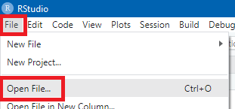
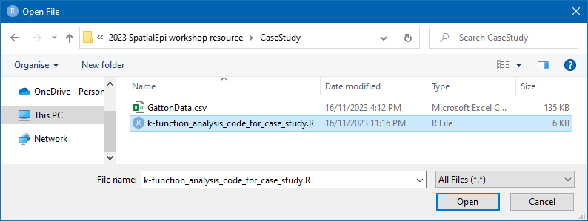
Opening R file in RStudio
In RStudio, open the “File” menu select “Open File”.
From the “Open File” window, navigate to the folder containing the R code file, select “k-function_analysis_code_for_case_study.R”, and click on “Open”

Slide 61
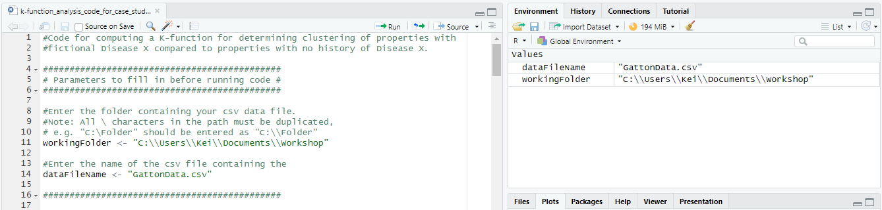
Setting data file parameters
The first section of the R file is for setting parameters related to the data file
Set the workingFolder variable to the folder where you saved the file GattonData.csv
Note: You will need to use two slashes in the folder name instead of one
Set the dataFileName variable to GattonData.csv
Run code by clicking on the Run button or by pressing CTRL+ENTER on each line of code
Variables will appear in the Environment tab on the top right of the window

Slide 62
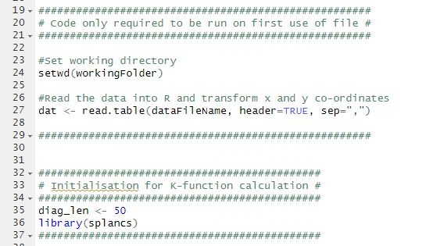
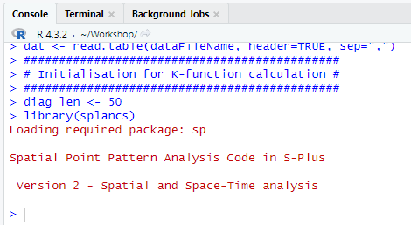
Loading data file and setting K-function parameters
The next two blocks of code do not require any changes and can just be run
The first block is for loading the data file
The second block is for setting a parameter used in K-function analysis and loading the splancs package

Slide 63
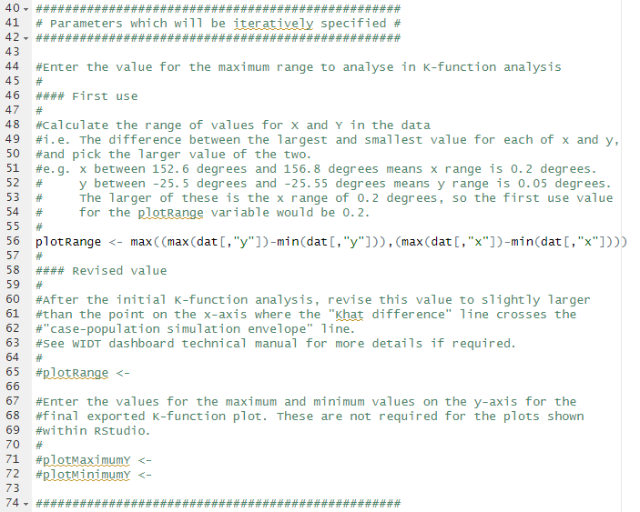
Setting K-function analysis range
This block of code is for setting the plotting range considered for the K-function analysis
This will be iteratively revised based on preliminary results of the analysis
This value can be automatically calculated for the first iteration
The code picks the larger out of range of x coordinates and range of y coordinates
This should result in 0.10196…
Three commented lines for setting variables will be modified later

Slide 64
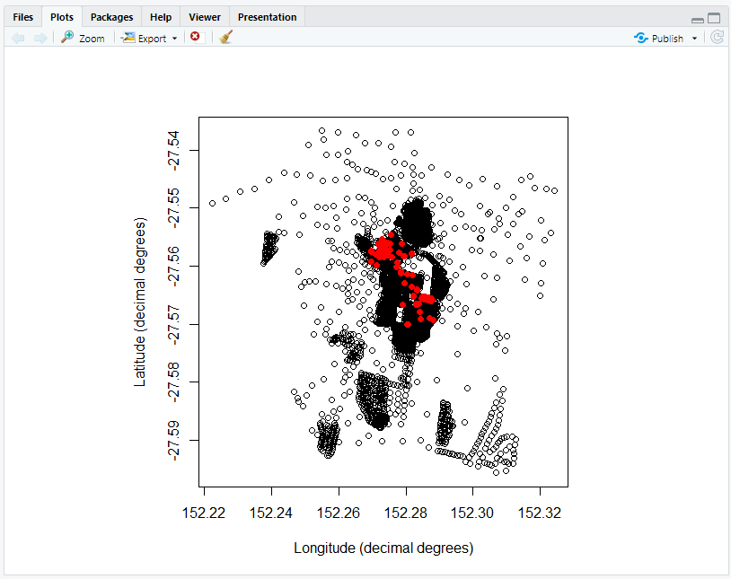
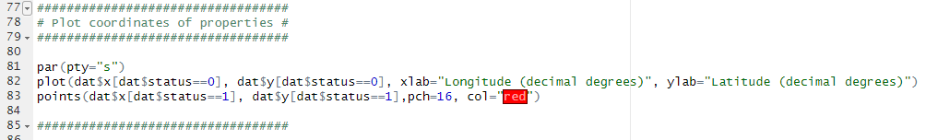
Plotting dataset coordinates
This block of code is for plotting the coordinates in the data file
A coordinate plot will appear in the Plots tab in the bottom right of the window
Red circles = cases
Hollow circles = controls
This step is to ensure that the input data has been loaded correctly and matches the area of Gatton
You can click on the Zoom button to look closer at the data

Slide 65
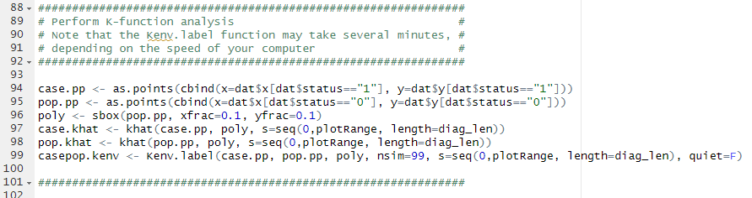
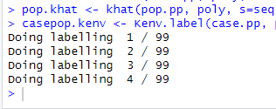
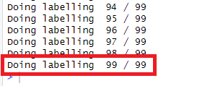
Perform K-function analysis calculations
The next section of code performs the K-function analysis calculations
The code will first calculate k̂ (khat) (result of spatial autocorrelation simulation) for both properties with Disease X history (case.khat) and properties with no Disease X history (pop.khat).
It then calculates the envelope of difference of khat results using the Kenv.label function with 99 iterations and stores the result in casepop.kenv. This last line may take a few minutes to execute.
The progress of this process will be indicated in the “Console” panel
The calculations are completed once you see the line showing the 99th iteration

Slide 66
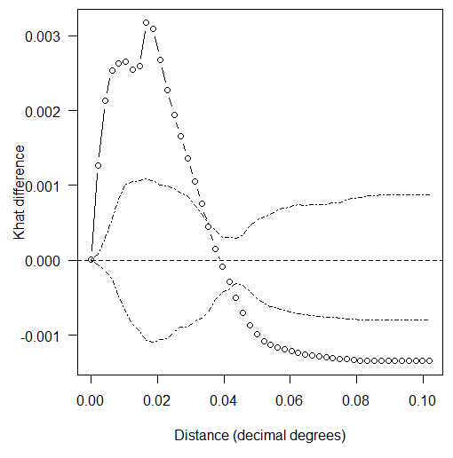
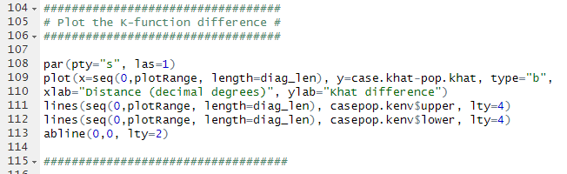
Plotting results of K-function analysis
The next section of code will plot the results of the K-function analysis calculations
The plot contains the Khat difference (Case Khat – Population Khat), shown in the bubble line, against the case-population simulation envelope, shown in dotted lines
Question: Which part of the plot do we want to focus on?
Answer: Area left of bubble line crossing dotted line (near 0.04) and Khat difference between roughly -0.0015 and 0.0035

Slide 67
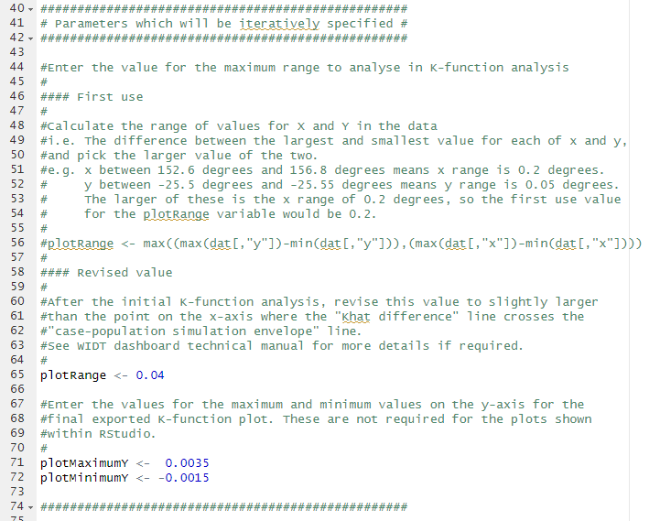
Revising plot range
Return to the section earlier in the code for setting plotRange
Add a # before the automatically calculated version of plotRange
Remove the # before the second line for plotRange and add the value 0.04
Remove the # before plotMaximumY and plotMinimumY and set these to 0.0035 and -0.0015, respectively
Rerun these three lines of code, and all subsequent codes up to plotting the results of the K-function analysis

Slide 68
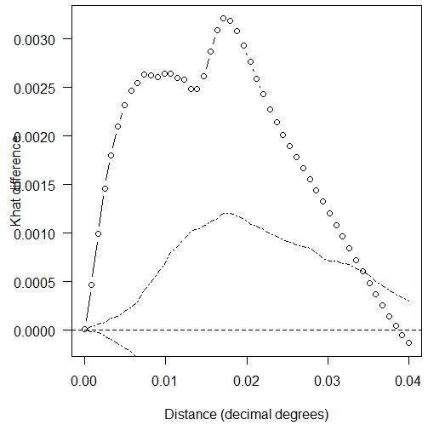
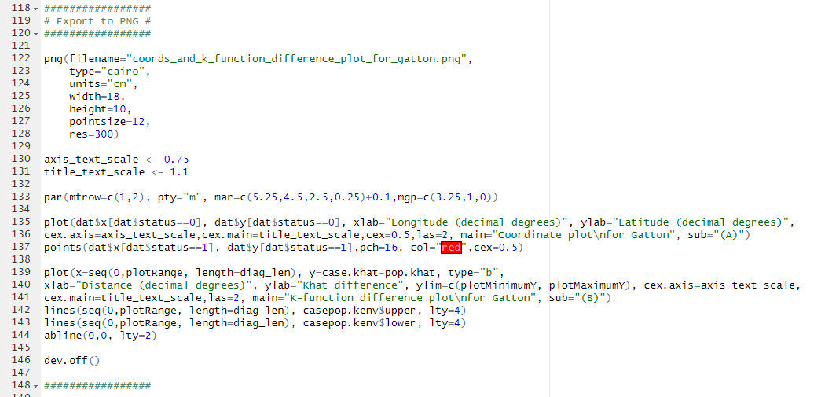
Revised K-function plot
Plot now more clearly shows the area to the left of where the bubble line crosses the dotted line
Run the last section of code to produce a PNG image file in the same folder as the data file, containing both the coordinate plot and Khat difference plot, with the file name: coords_and_k_function_difference_plot_for_gatton.png

Slide 69
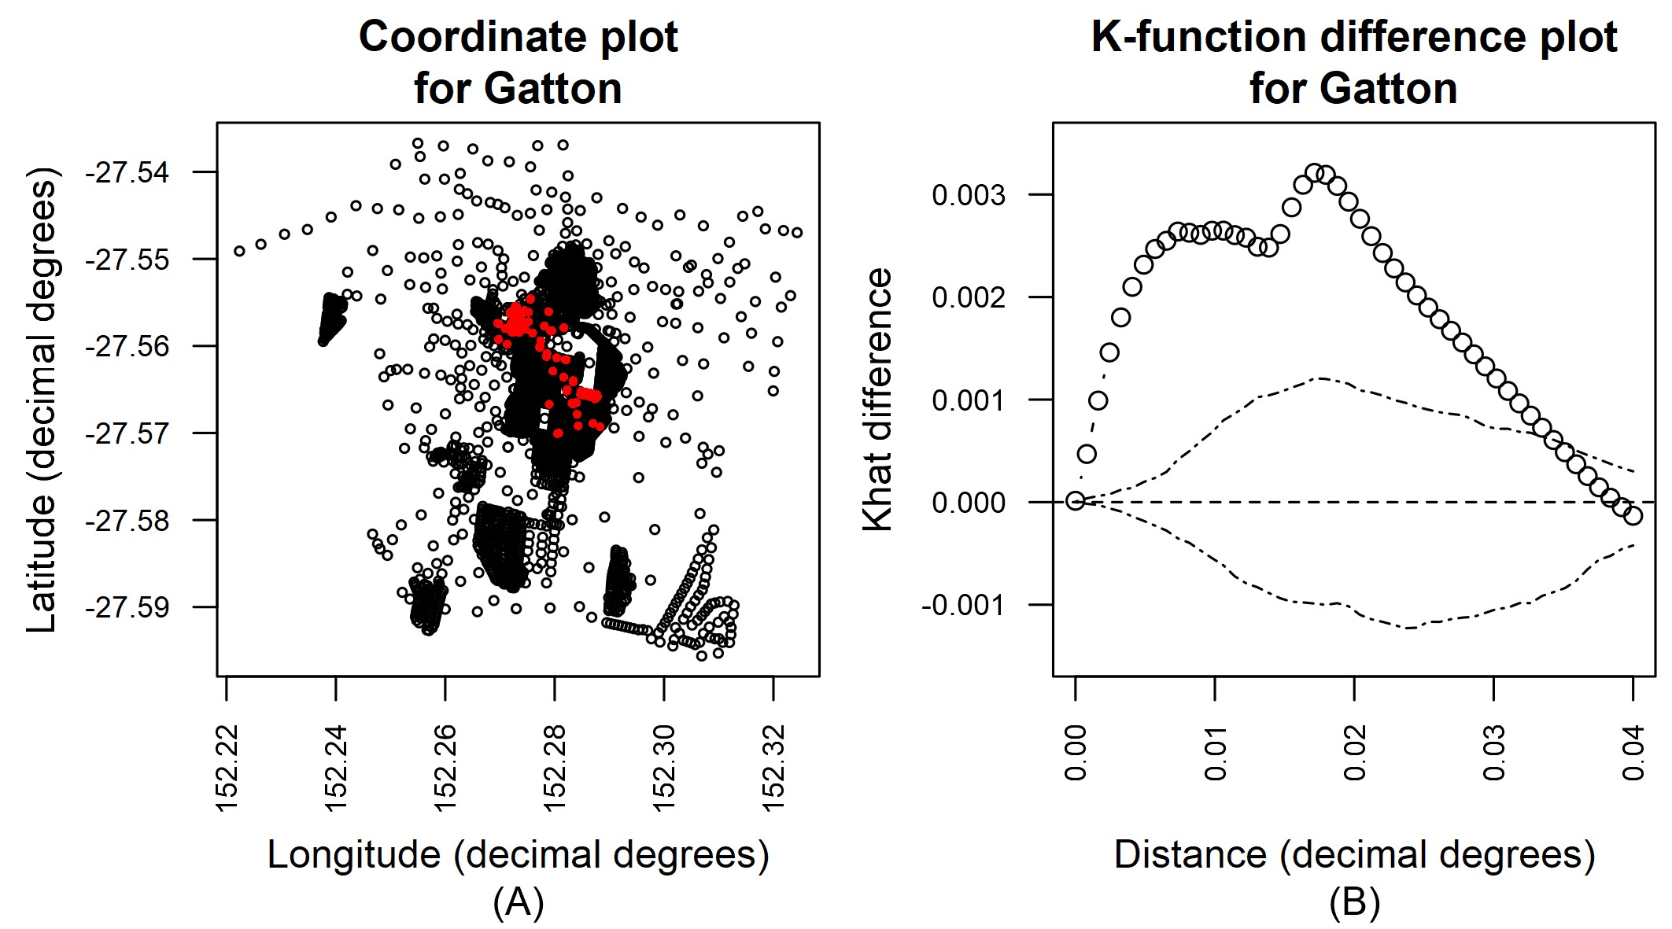
Exported coordinate and K-function difference plot
Your PNG should look like this

Slide 70
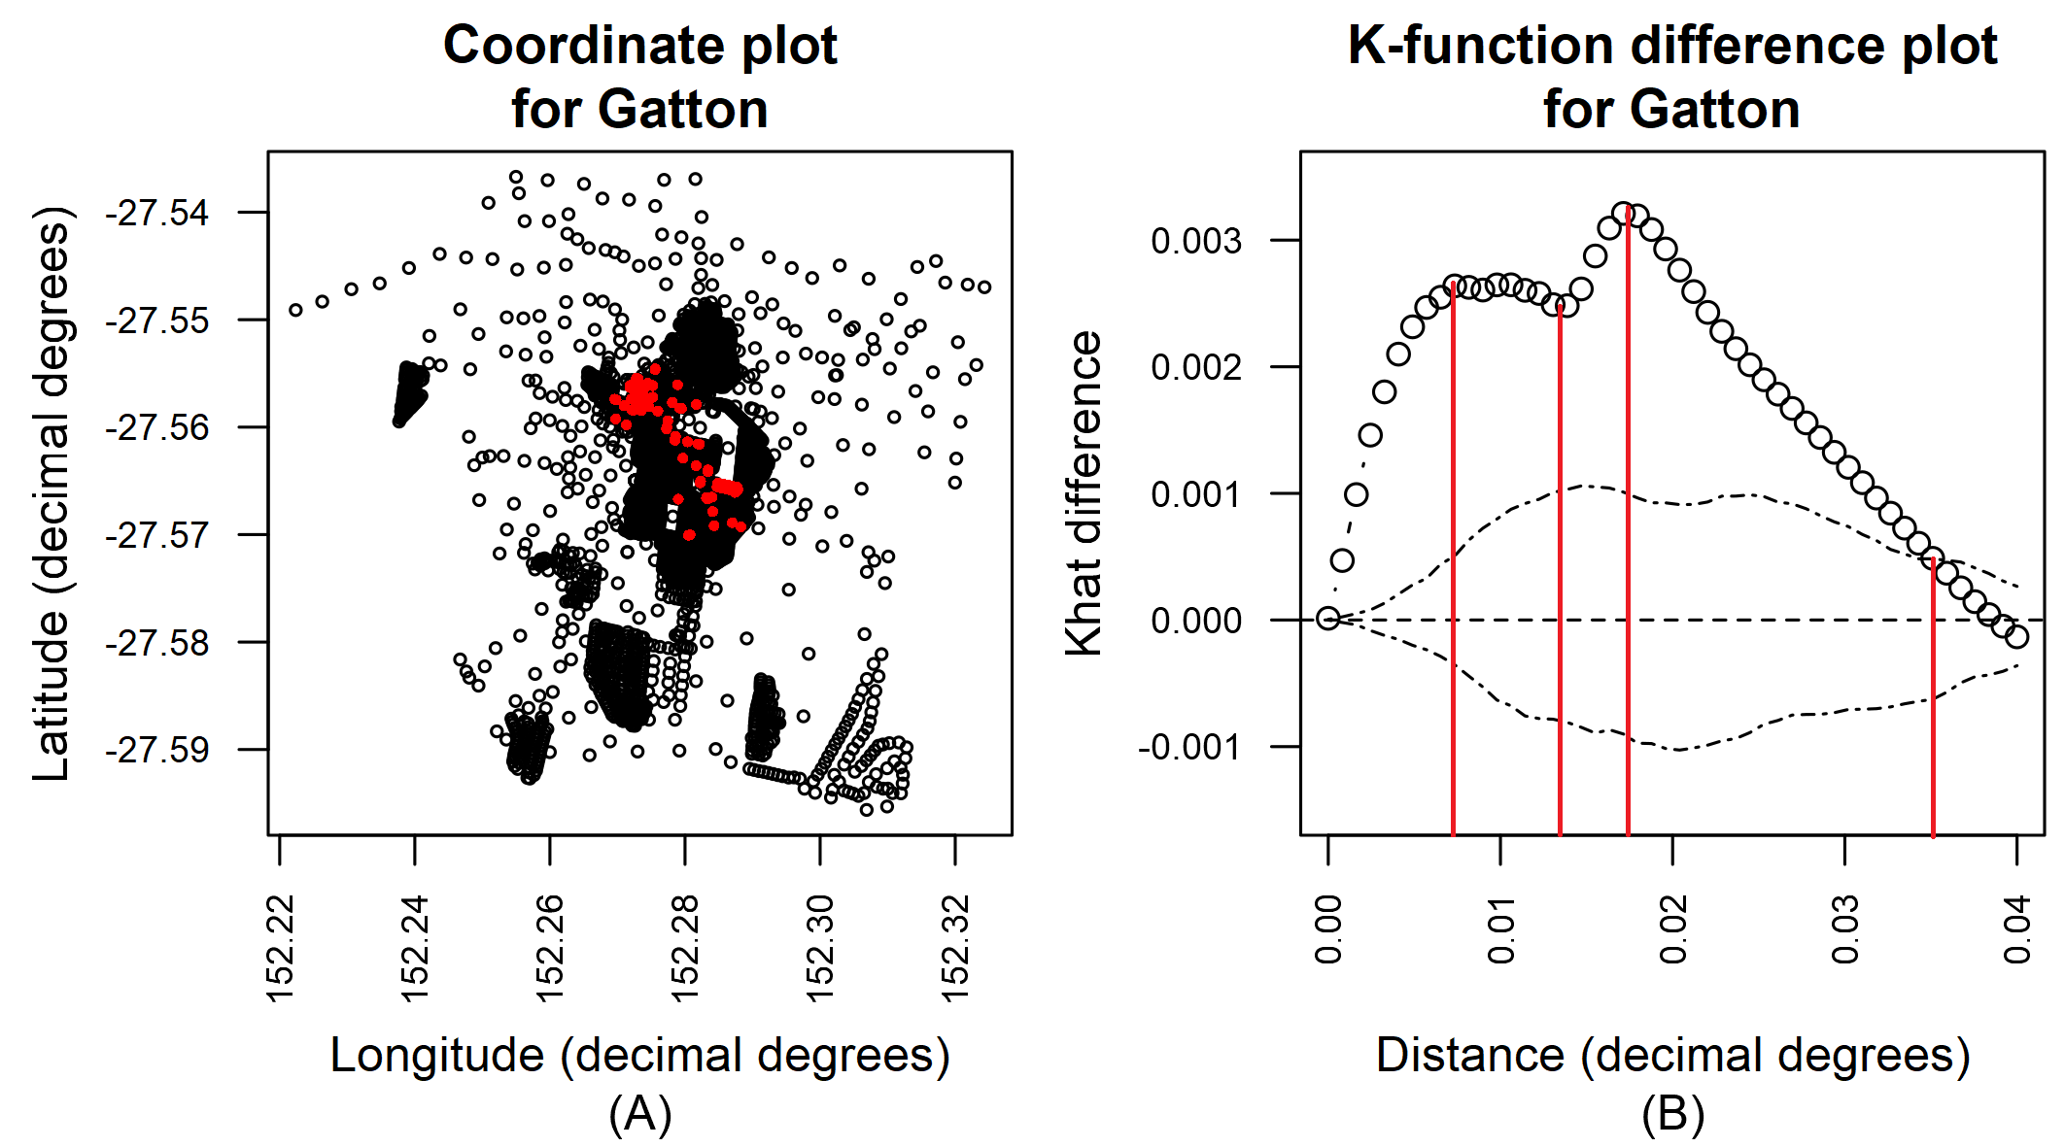
Interpreting K-function analysis plot
First peak at 0.007 and flat up around 0.011
Second peak at 0.017
Bubble line and dotted-line cross at 0.035
We can determine:
Clusters of 777 m (blue)
Reducing cluster strength up to 1.55 km
Circumscribed cluster of 1.89 km (pink)
Gradually decreasing cluster strength up to 3.89 km (orange)
Drawing vertical lines on plot can help measure cluster sizes. Zoom coordinate plot to more easily identify location of clusters.

Slide 71
Interpreting K-function analysis plot
Two main clusters in north-west and south-east areas of central Gatton with diameter of approximately 777 m
Combined cluster with diameter of approximately 1.89 km has similar cluster strength to individual clusters
These clusters suggest heterogeneous risk factor influencing infection with fictional Disease X at two distance scales
These will need to be investigated further using modelling

Slide 72
Thank you

